Slide 1
2nd Order CFA
Byrne Chapter 5

Slide 2
2nd Order Models
The idea of a 2nd order model (sometimes called a bi-factor model) is:
You have some latent variables that are measured by the observed variables
A portion of the variance in the latent variables can be explained by a second (set) of latent variables

Slide 3
2nd Order Models
Therefore, we are switching out the covariances between factors and using another latent to explain them.

Slide 4
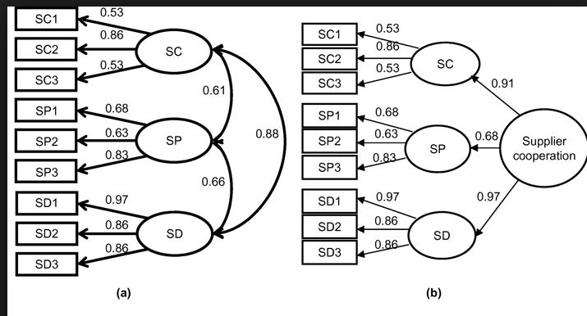

Slide 5
Identification
Remember that each portion of the model has to be identified.
The section with each latent variable has to be identified (so you need at least one loading set to 1).
The section with the latents has to be identified
(draw)

Slide 6
Identification
You can do get over identification in a couple of ways:
Set some of the loadings in the upper portion of the model to be equal (give them the same name)
You can set the variance in the upper latent to be 1
You can set some of the error variances of the latents in the lower portion to be equal

Slide 7
Critical Ratio of Differences
Lists the CR of the difference between parameter loadings
Remember that CR are basically Z scores
Located in the analysis properties -> output window

Slide 8
Critical Ratio of Differences
When you get this output, all the parameters will get labels (to be able to tell what’s going on)
The chart will look like a correlation table (similar to residual moments)
You are looking for parameters with very small values close to zero.
That means they have basically no difference in magnitude

Slide 9
Critical Ratio of Differences
The logic:
If two parameters are basically the same, why are we wasting a degree of freedom estimating the second one?

Slide 10
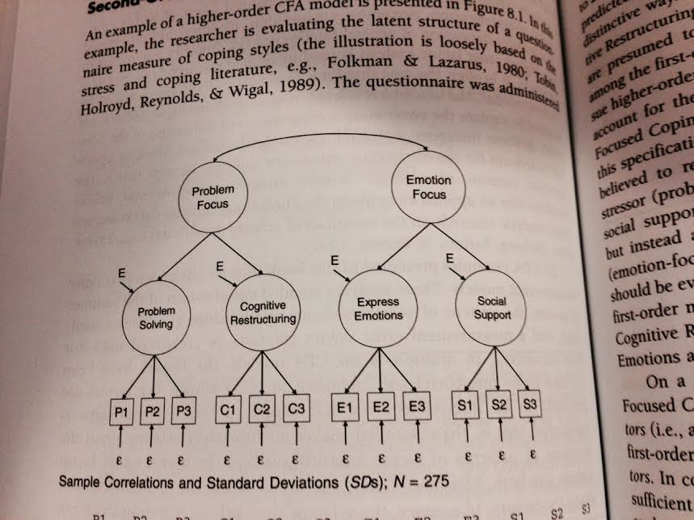
Let’s Try It!

Slide 11
A quick review
SEM assumes that the latent variables are continuous
Well, sometimes that isn’t the data we actually have.

Slide 12
Issues
Things that can happen when you assume continuous but they aren’t:
Correlations appear lower than they are, especially for items with low #s of categories
Chi-square values are inflated, especially when items are both positive and negative skewed

Slide 13
Issues
Things that can happen when you assume continuous but they aren’t:
Loadings are underestimated
SEs are underestimated

Slide 14
Categorical Data
But! If you have 4-5+ categories and they approximate normal = you are probably ok
Solutions:
Special correlation tables + ADF estimation
Bayesian estimation! ☺

Slide 15
Bayesian Estimation
Definitions:
Prior distribution: a guess at what the underlying distribution of the parameter might be
(this sounds crazy! How am I supposed to know! But think about the fact that we traditionally assume distributions are normal for analyses, so is it so crazy?)
You just have to guess! But Amos does this for you actually.

Slide 16
Bayesian Estimation
Definitions:
Posterior distribution: distribution of the parameter after you have analyzed the data + the influence of the prior distribution
So you use the data to estimate the parameters but include a little bit of the prior distribution as part of your estimate for the parameter

Slide 17
Bayesian Estimation
Example of prior and posterior
Two things to notice:
How much data I have matters: the posterior is less influenced by the prior when you have more data
How strong I make my prior matters: the posterior is less influenced when you make a weak prior

Slide 18
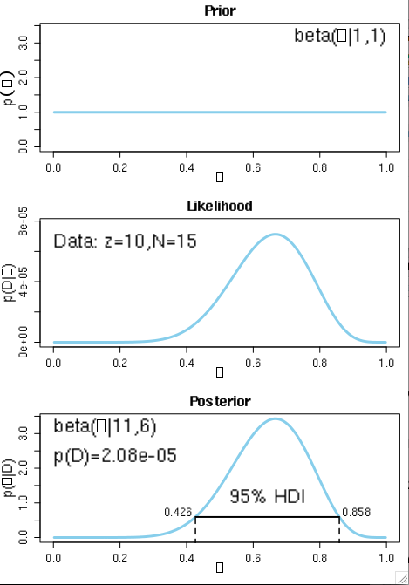
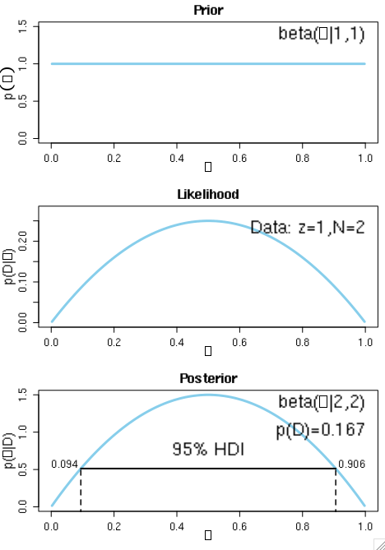

Slide 19
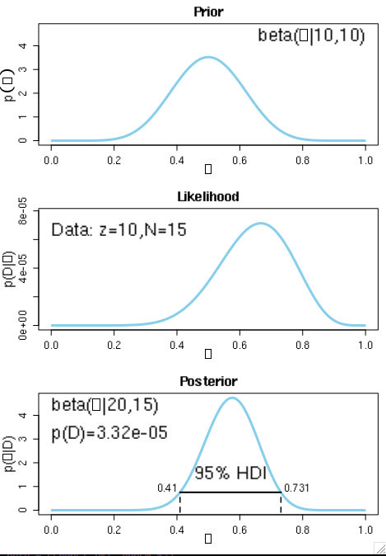
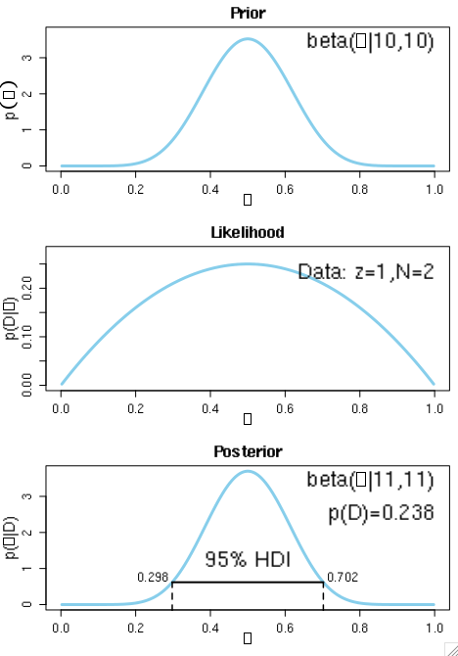

Slide 20
Bayesian Estimation
How to in Amos:
Go to Analysis properties (seriously, everything minus SRMR is in that window)
Turn on estimate means and intercepts
If you forget this step, you will get an error message saying “EEK!”

Slide 21
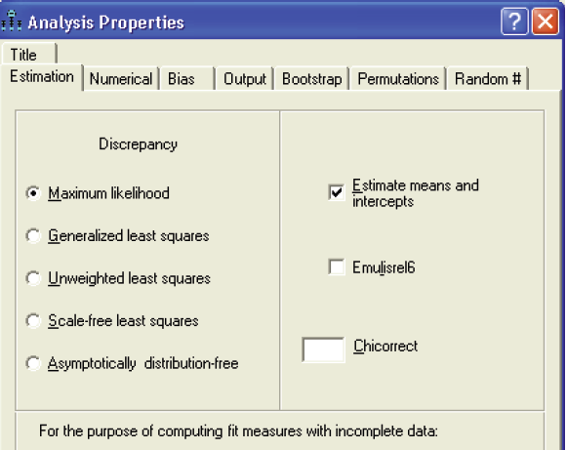

Slide 22
Bayesian Estimation
To run Bayes, click on the button with the little distribution on it
OR
Analyze > Bayesian Estimation

Slide 23
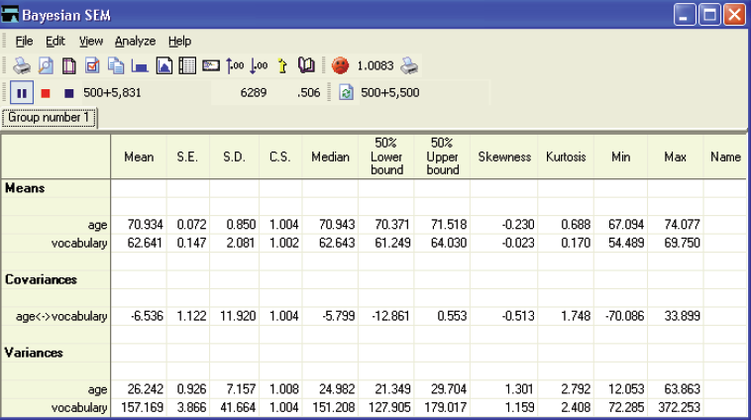
So what’s going on?

Slide 24
Things to Note
MCMC what?
Markov Chain Monte Carlo
Sometimes called a random walk procedure
Example

Slide 25
Things to Note
The pause button
This button stops the analysis from running
500 + ##
500 is called the BURN IN
Basically all MCMC analyses require a little bit of time before they settle down.
I like to think of it as a drunken walk at the beginning so you exclude that part.

Slide 26
Things to Note
500 + ###
The number part is how many steps the program has run to converge (come to a stable solution).
It’s going to be a big number, as many Markov Chains have to run 50,000 times to get a stable solution.

Slide 27
Things to Note
How do I know I have a stable solution?
Unhappy face
Happy face
1.002 and below result in happy faces
But 1.10 is a common criteria as well
You can stop the algorithm at any time

Slide 28
Things to Note
Next you get the loadings, means, intercepts, covariances, etc.
The MEAN column is your estimate
SE = standard error for all those samples – will be small
SD = the estimate of SE for ML estimation
CS is the convergence statistic

Slide 29
Things to Note
Posterior Icon
Gives you the posterior distribution
You can get the first + last distribution
You want these to overlap a lot

Slide 30
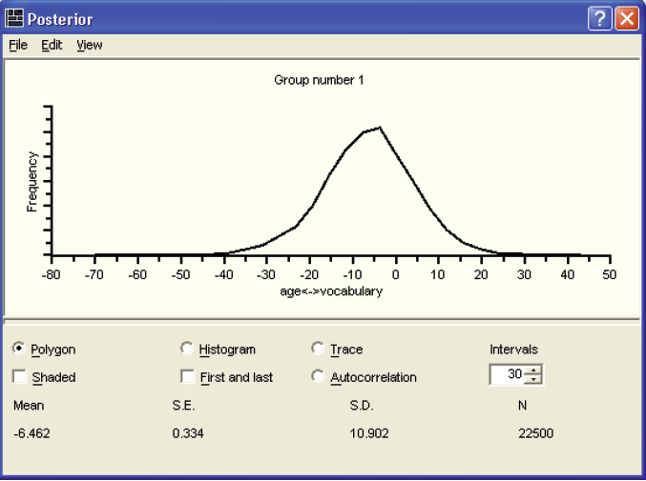

Slide 31
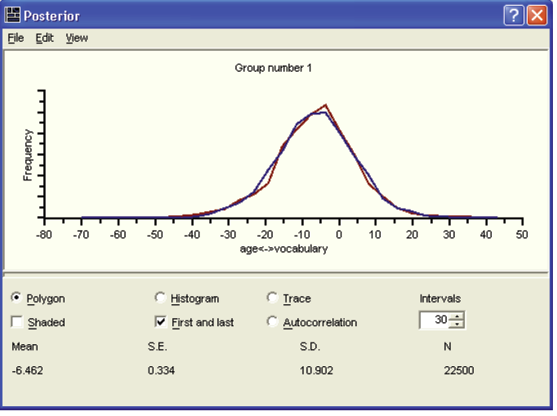

Slide 32
Things to Note
Autocorrelation
This fancy word is the problem of the starting point.
If values are correlated, it implies that you didn’t get a good convergence of the data … aka when the walk started you got stuck somewhere or distracted (not a good thing).

Slide 33
Things to Note
You want the autocorrelation picture to be positively skewed and drop off to zero at the end.

Slide 34
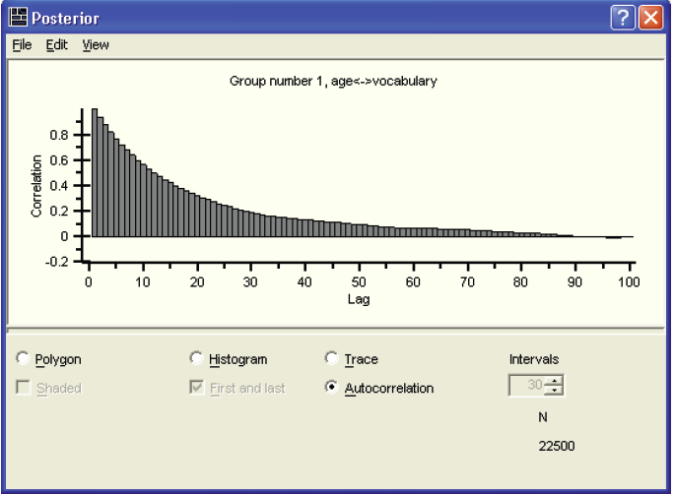

Slide 35
Things to Note
Trace plots
Trace plots show you the walk the MCMC chain took. It should look like a very messy bunch of squiggles
A problem (usually autocorrelation) would be if it looked like a bunch of lines together, then a break, then a bunch of lines (draw)

Slide 36
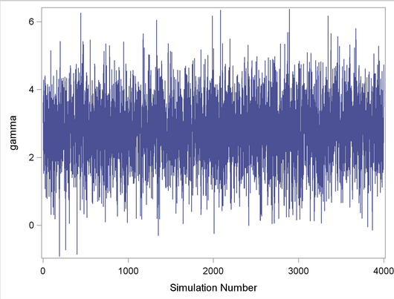

Slide 37
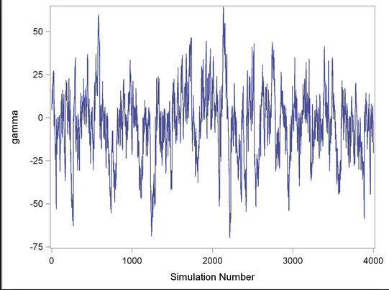

Slide 38
Let’s Try it!
Let’s run a Bayesian analysis on Byrne’s second order model (you need full data for Bayes, not just correlations)

Slide 39
